Slide 1
Spatial Filtering
Patrick kevorkian

Slide 2
Topics
Introduction
Brief Code review
Max Filter
Min Filter
Median Filter
Laplacian Filter
Robinson
Sobel
High Boost Laplacian
Prewitts

Slide 3
Spatial Filters
Grid imposed on area of pixel values around origin pixel
Calculation
Grid moves to next pixel in image array
Calculations in examples done in 2 ways
Min, Max, and Median
Convolution (element wise)
 | Origin

Slide 4
Code review
Python
Aquire image, convert to greyscale (using Skimage)
Show original image
Define Grids as arrays
No padding used
Iterate through image array (Col wise) without going to very edge
Apply filter to grid array values
Place new value in new image array
Display new image

Slide 5
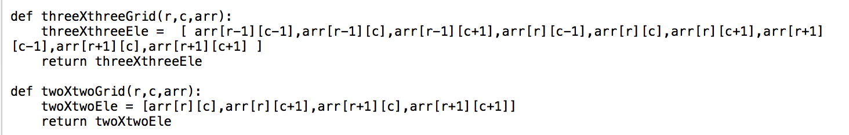
Code review
grids

Slide 6
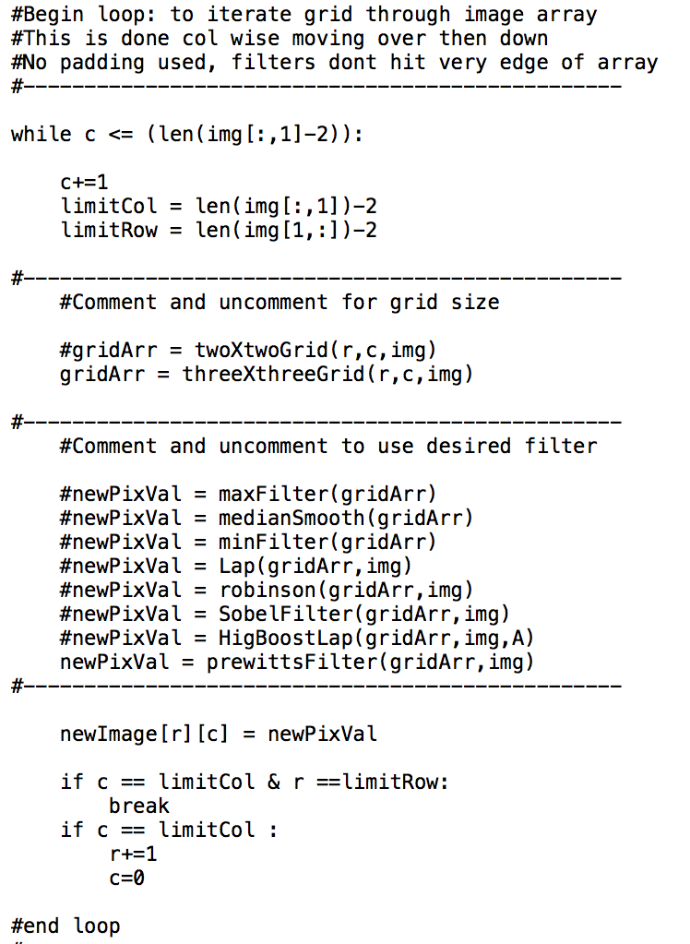
code review
iterating image array

Slide 7
Max filter
Super imposed over elements around origin pixel
Elements are then sorted (least to greatest)
New pixel value is the largest value
Value placed into new array at same position as origin pixel
Grid moves on to next pixel

Slide 8
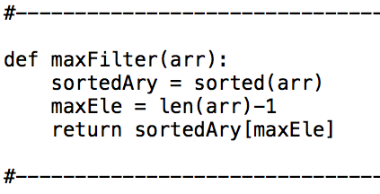
MAX Filter
function

Slide 9
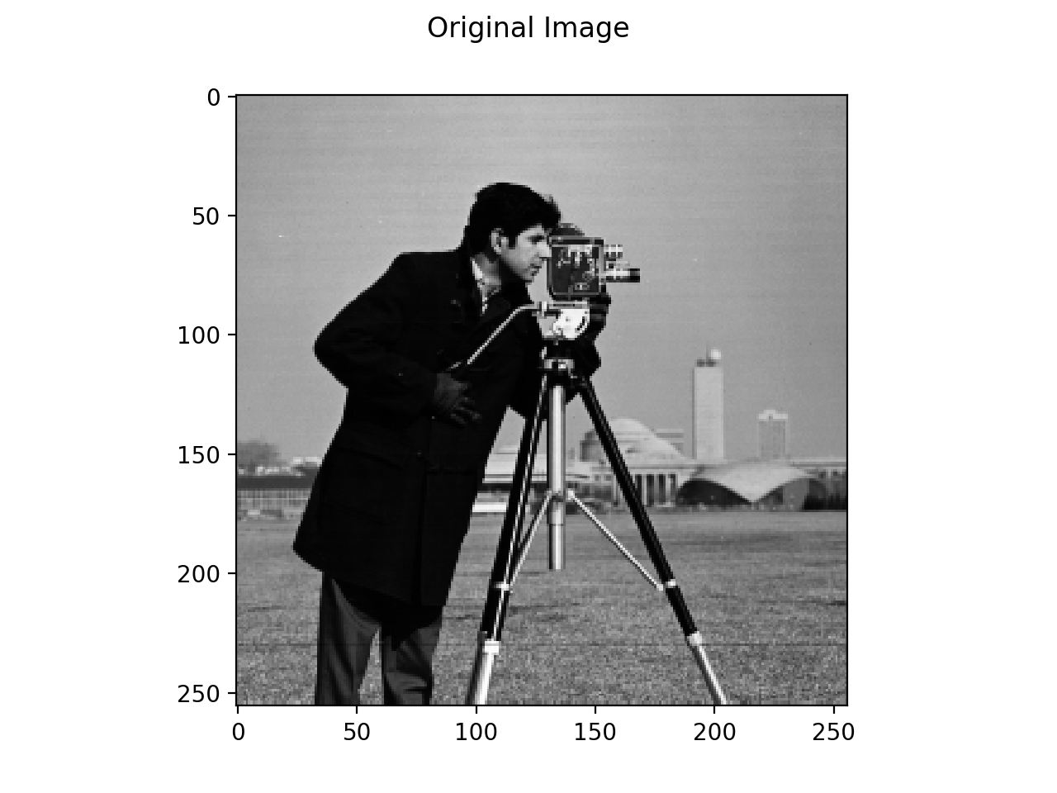
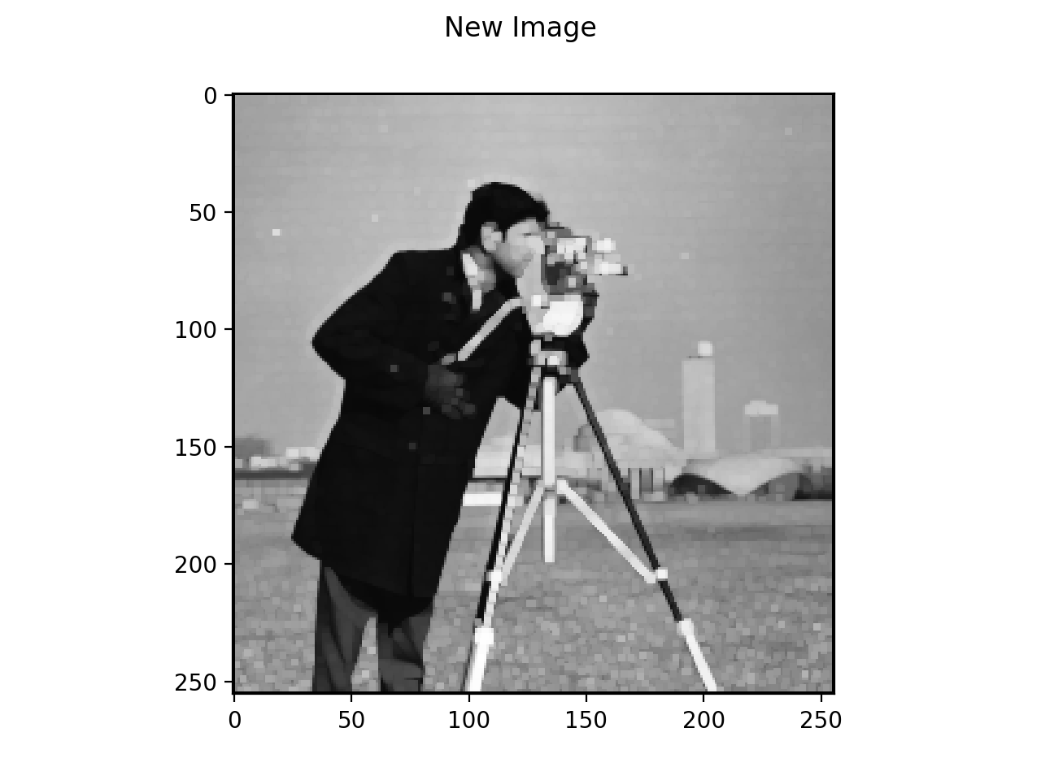
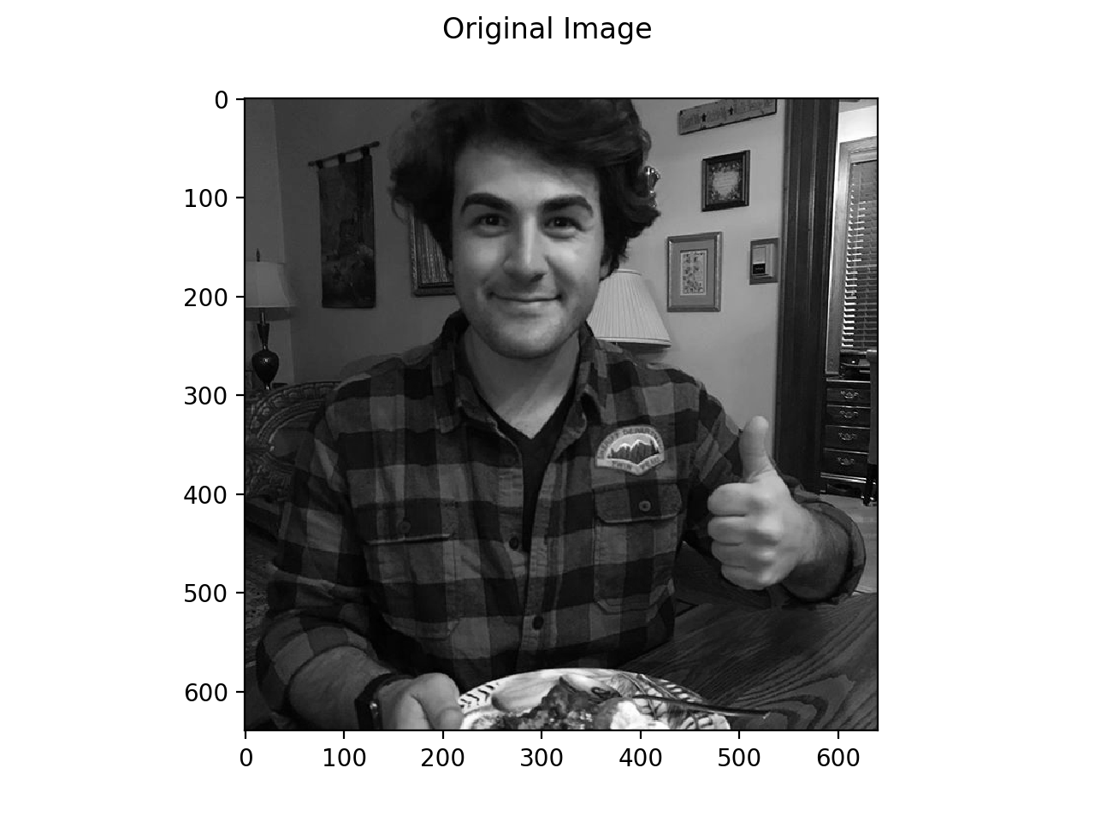
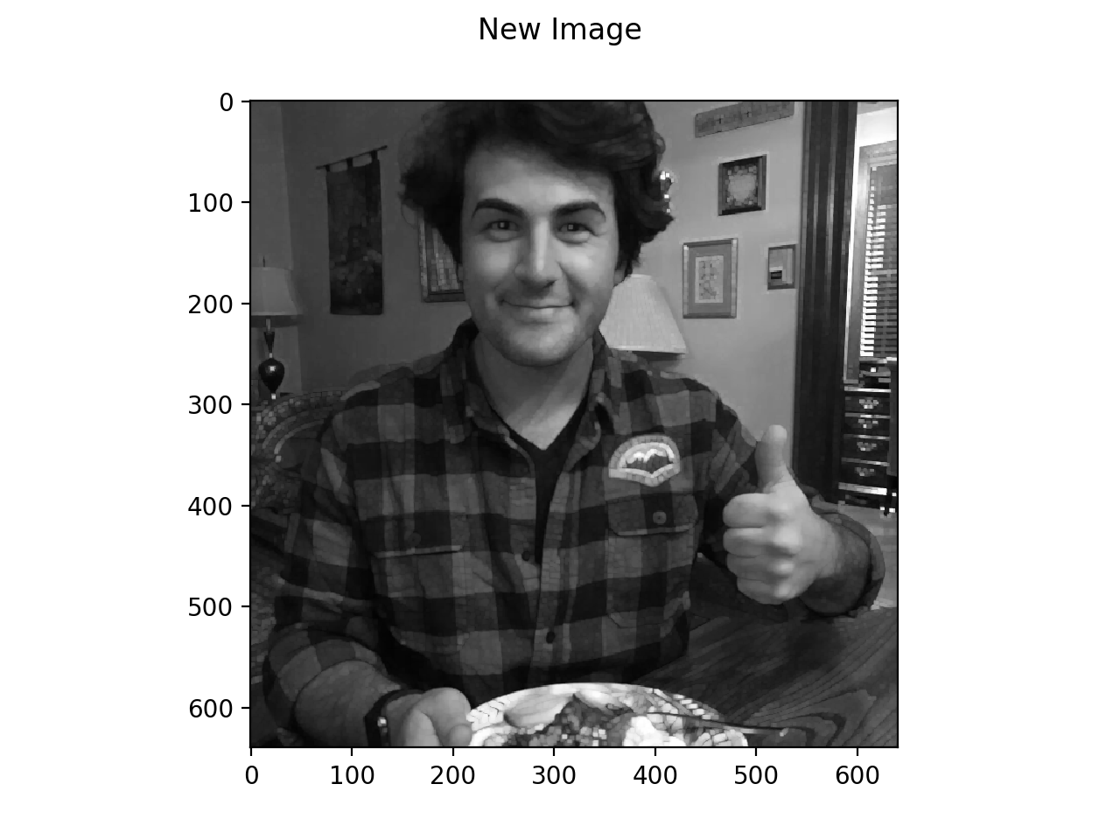

Slide 10
Min filter
Super imposed over elements around origin pixel
Elements are then sorted (least to greatest)
New pixel value is the smallest value
Value placed into new array at same position as origin pixel
Grid moves on to next pixel

Slide 11
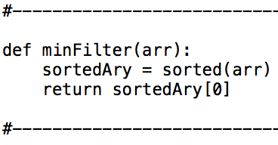
min filter
function

Slide 12
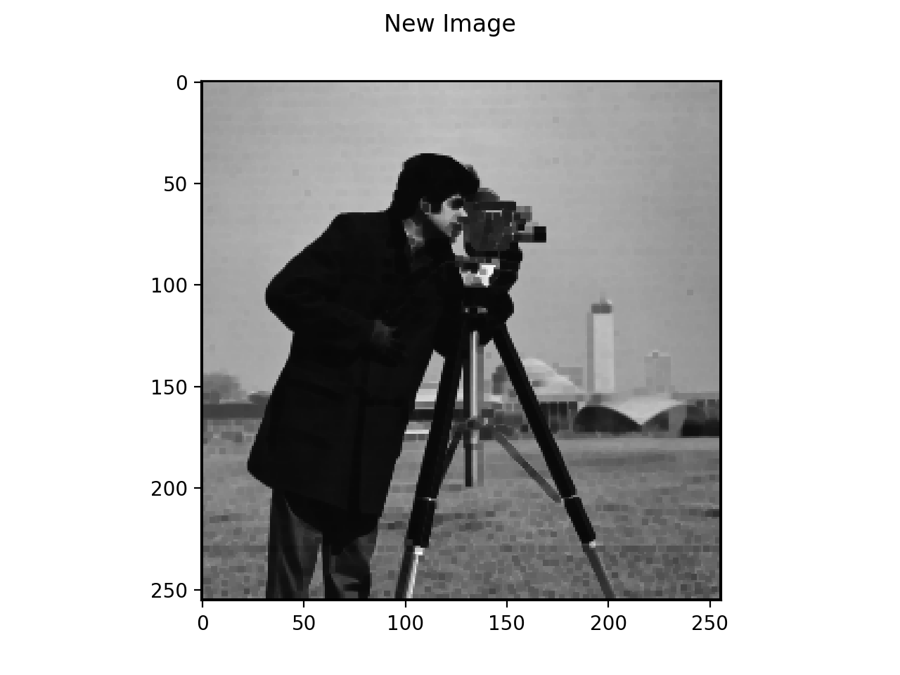
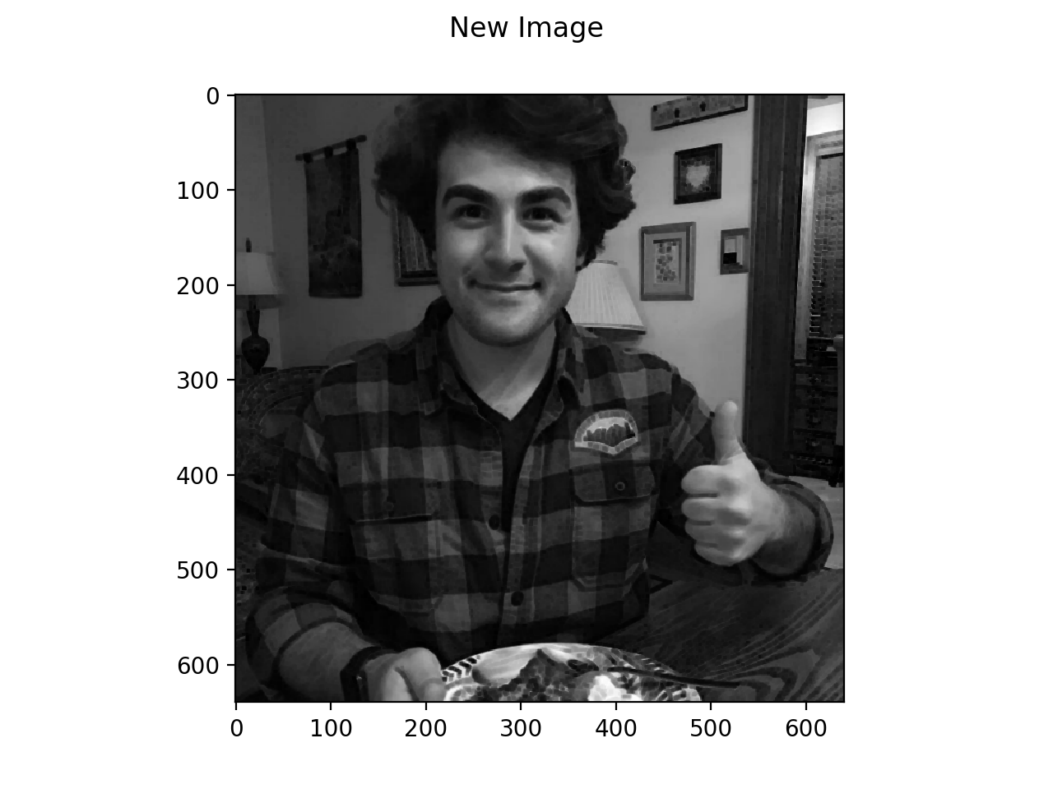

Slide 13
Median Filter
Super imposed over elements around origin pixel
Elements are then sorted (least to greatest)
New pixel value is the median value of array elements
In 3X3 the median value is (9/2)+1
Value placed into new array at same position as origin pixel
Grid moves on to next pixel

Slide 14
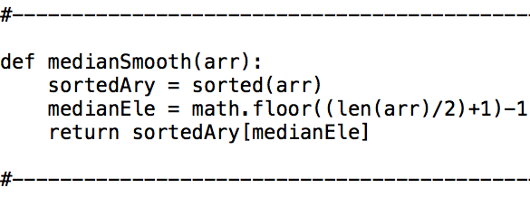
Median Filter
function

Slide 15

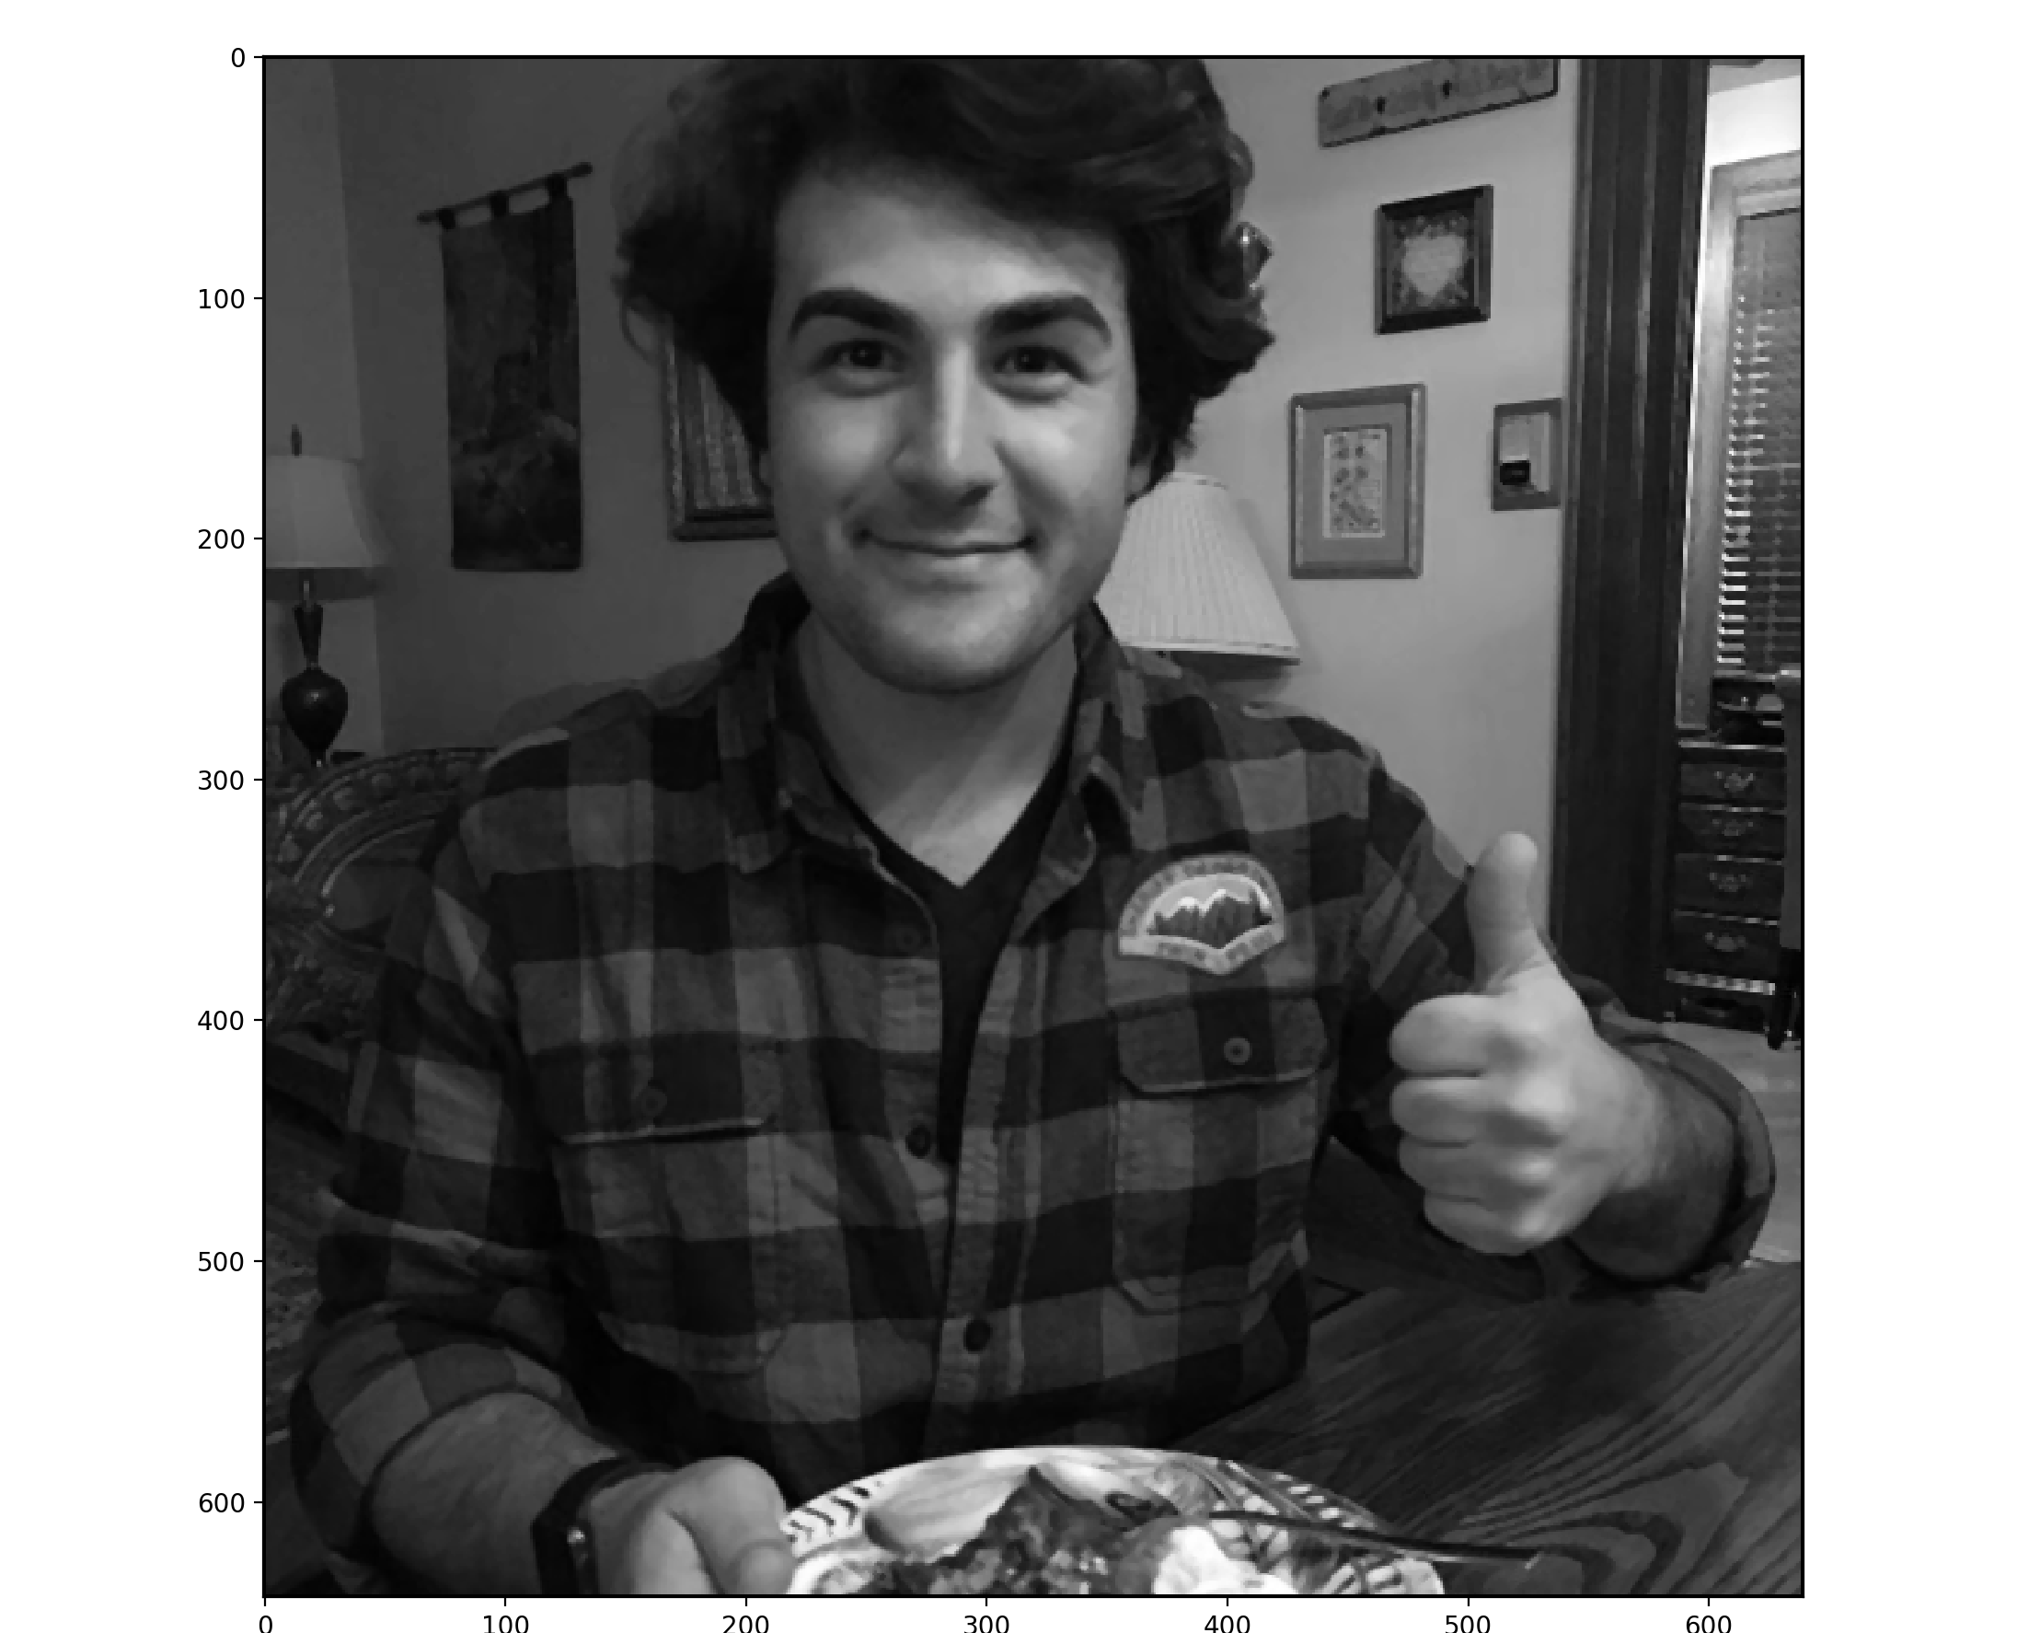

Slide 16
laplacian Filter
the standard Lap Filter
Supper imposed
Elements of the filter and elements of pixels imposed are multiplied
Then added
Moves to next pixel
0 | -1 | 0
-1 | 4 | -1
0 | -1 | 0

Slide 17
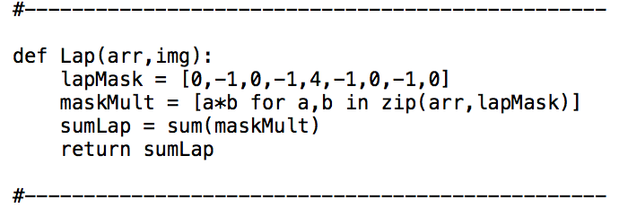
Lap Filter
function

Slide 18
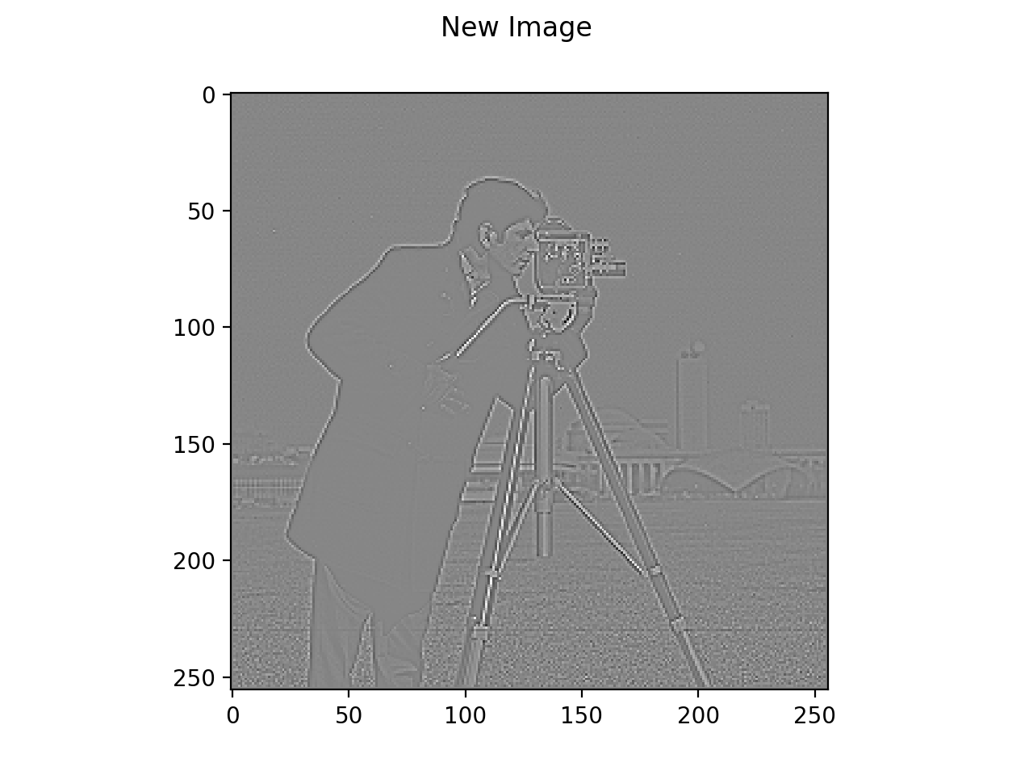
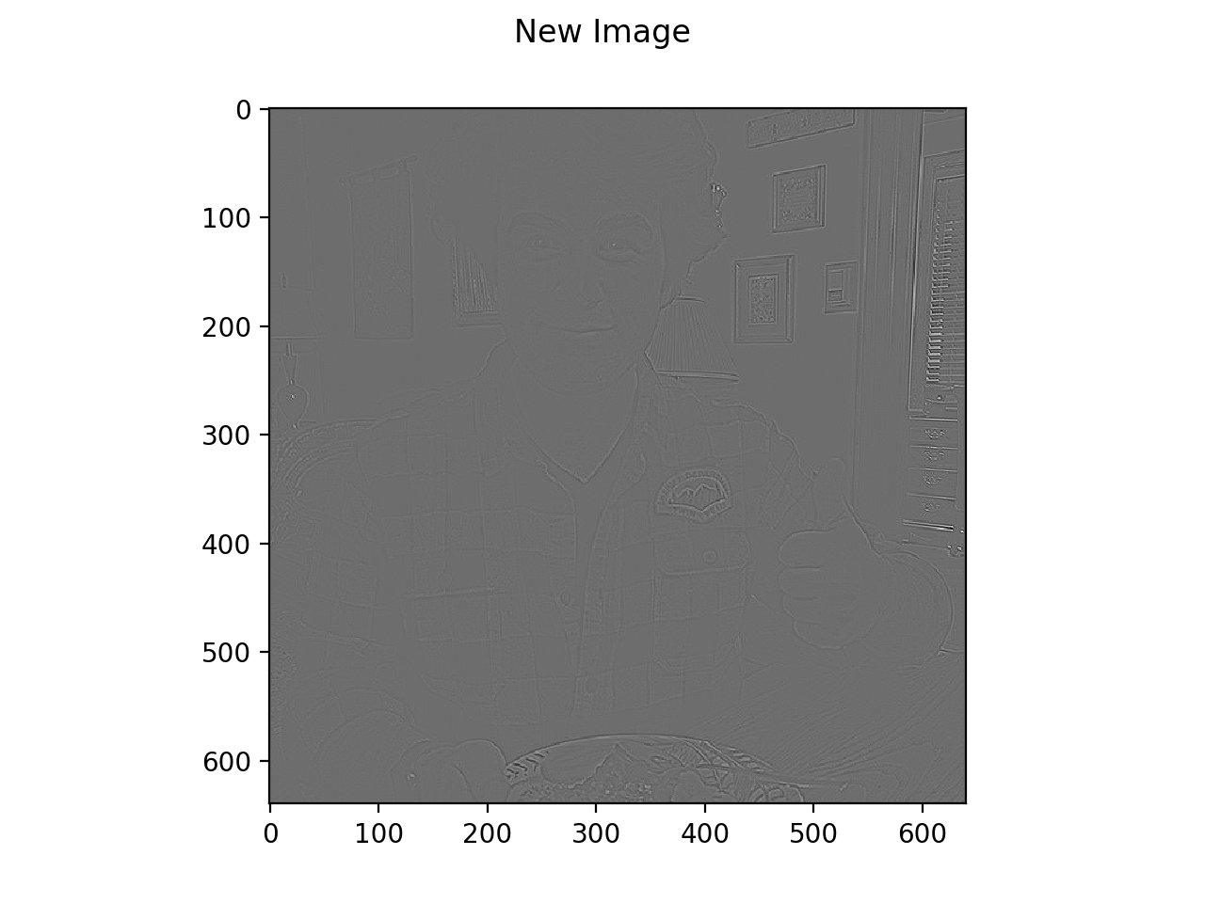

Slide 19
Robinson
2X2 Grid
2 kernels
Origin is filt[0][0]
Like before the filter is applied by element wise multiplication and added together
This is done with both filters and the absolute value of the each is added together.
1 | 0
0 | -1
0 | 1
-1 | 0

Slide 20
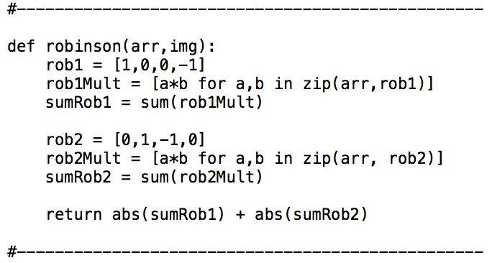
Robinson
function

Slide 21
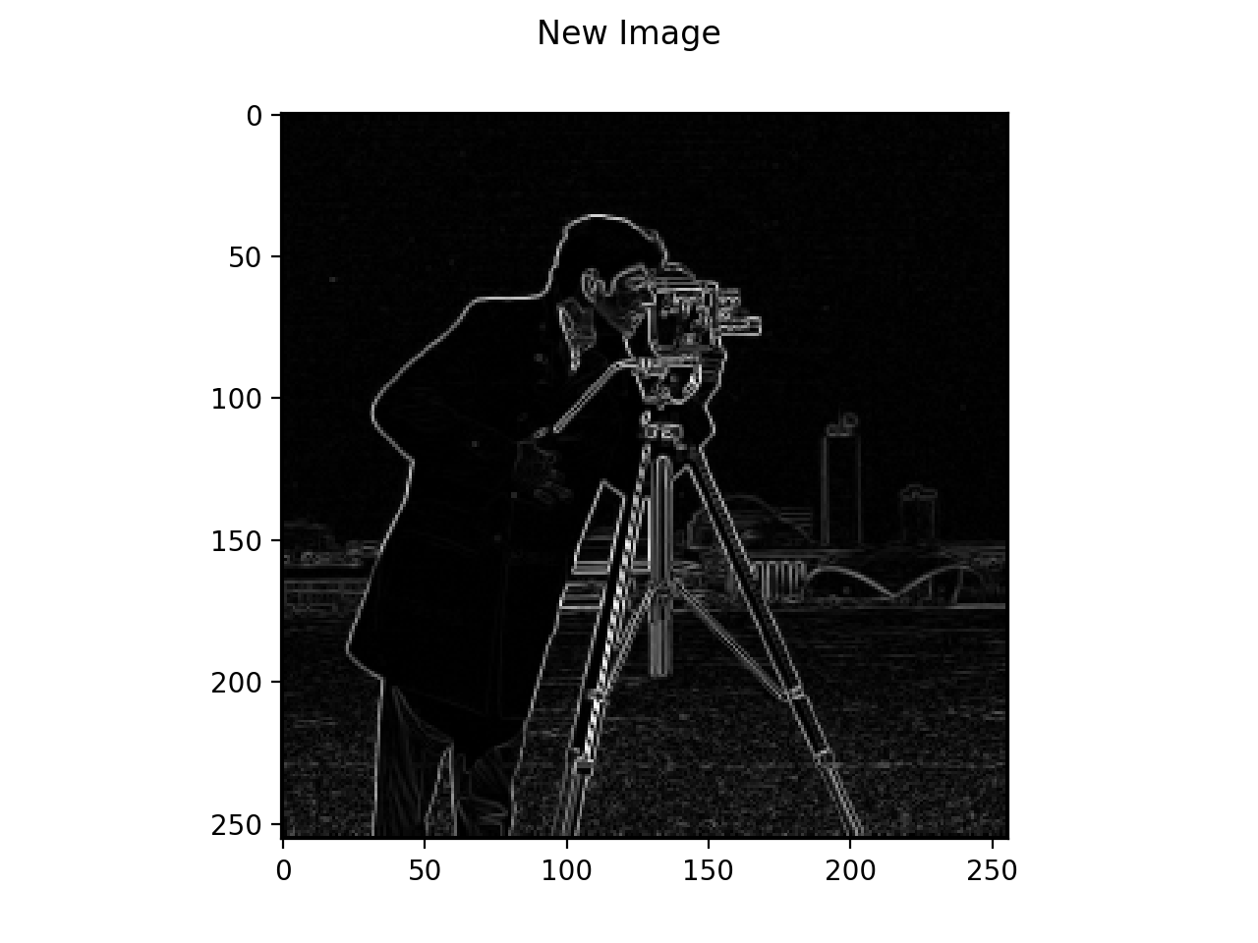
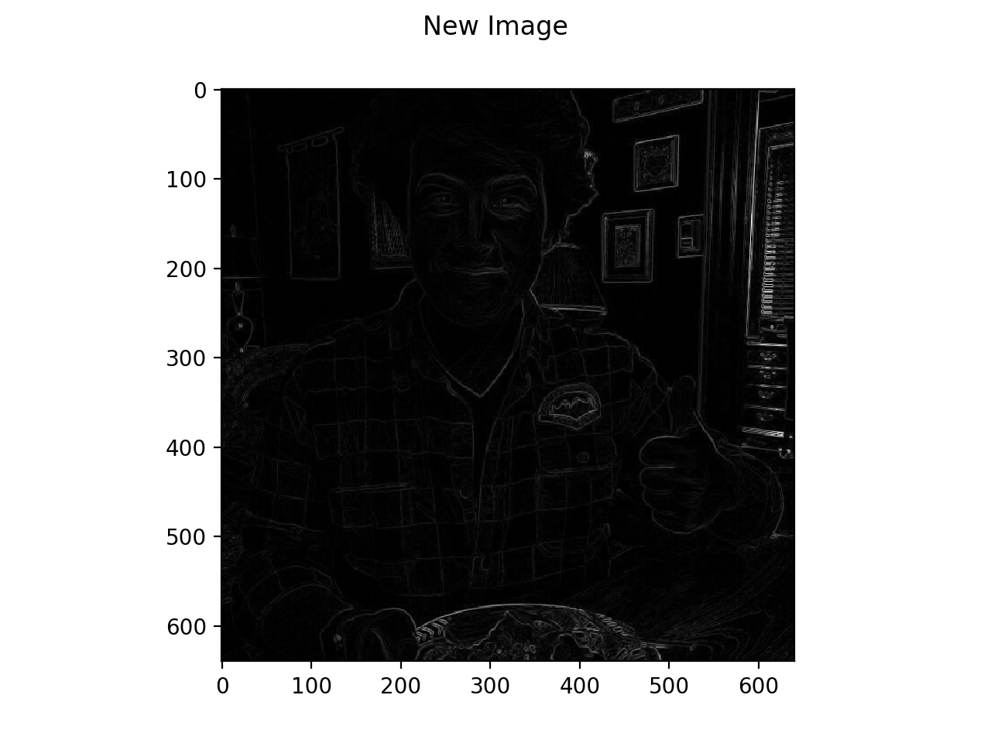

Slide 22
Sobel Filter
Isotropic 3X3 image gradient operator
Two kernels
Horizontal and vertical directions
Element wise Mult
Addition of results
Absolute value taken
1 | 0 | -1
2 | 0 | -2
1 | 0 | -1
1 | 2 | 1
0 | 0 | 0
-1 | -2 | -1

Slide 23
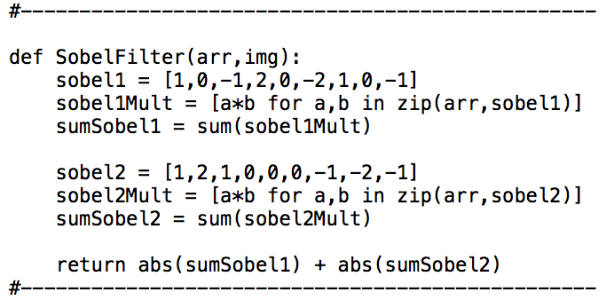
Sobel Filter
Function

Slide 24
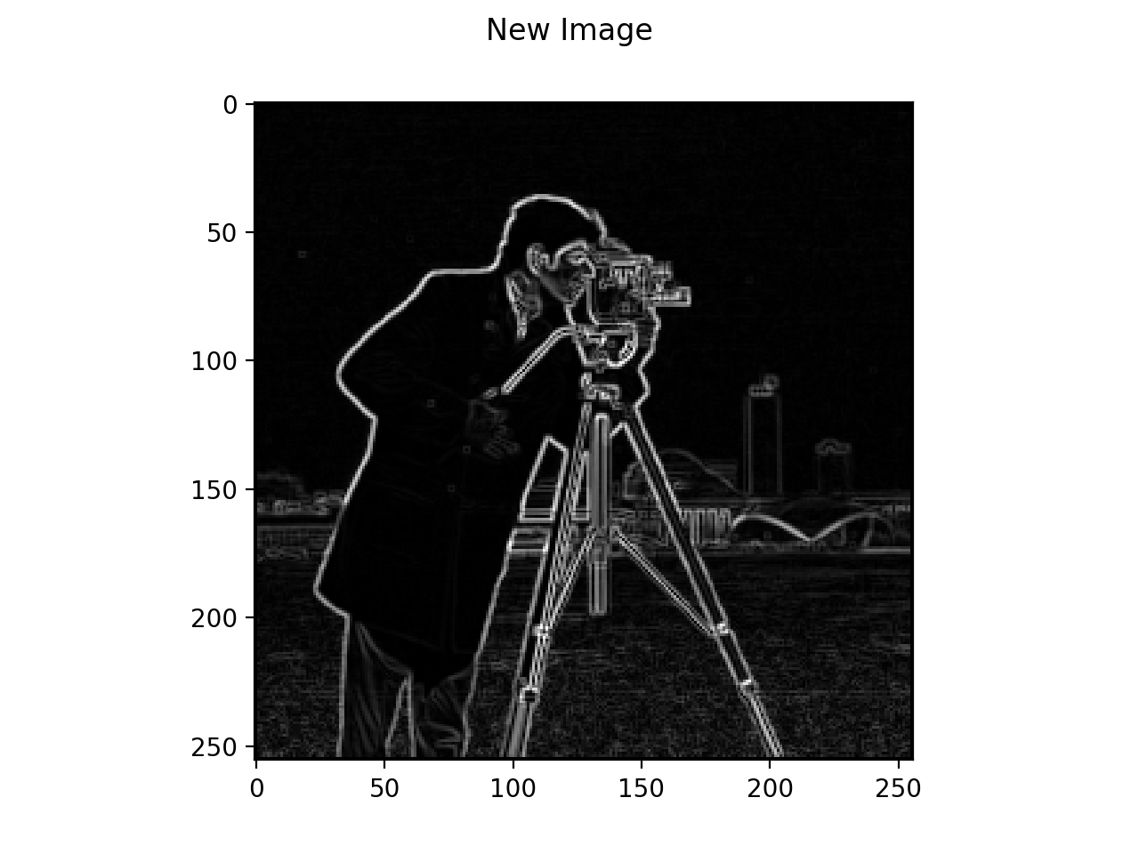
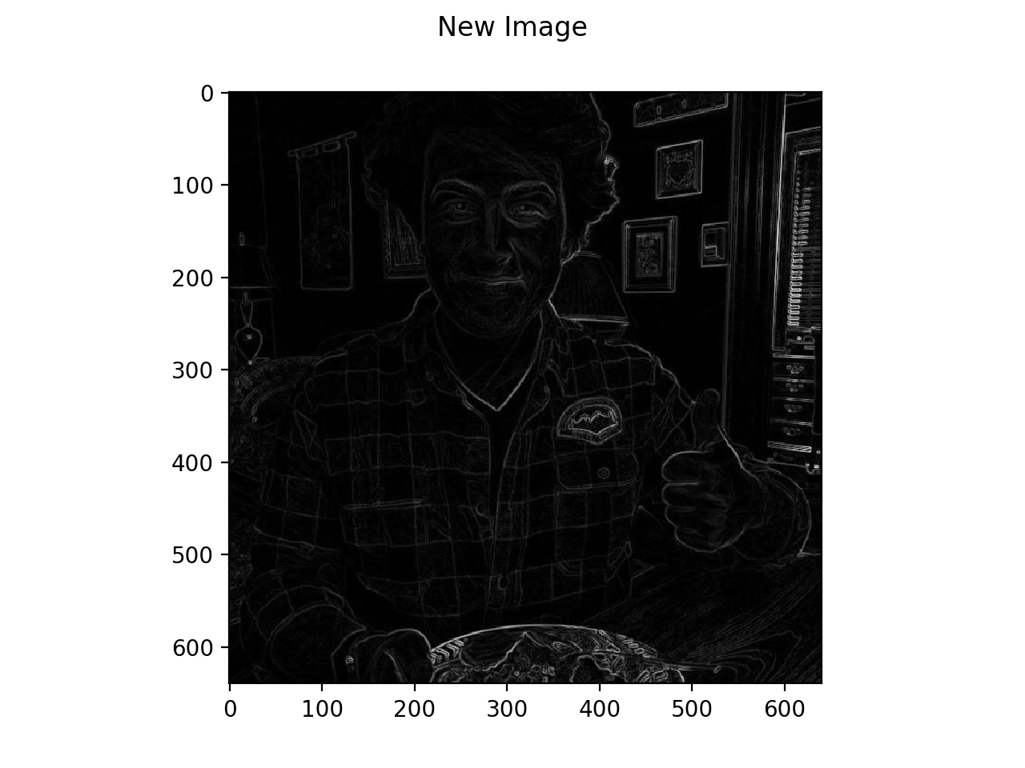

Slide 25
High boost lap
Same element wise operations
Important to emphasize high frequency components
But also not eliminating low frequency components
A is some constant (In example its 5)
Low are suppressed, high are enhanced
0 | -A | 0
-A | 4A+1 | -A
0 | -A | 0

Slide 26
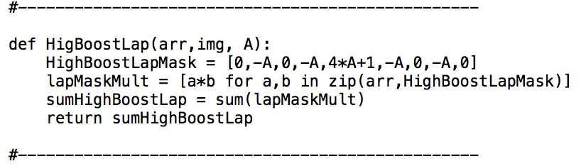
High Boost lap
function

Slide 27
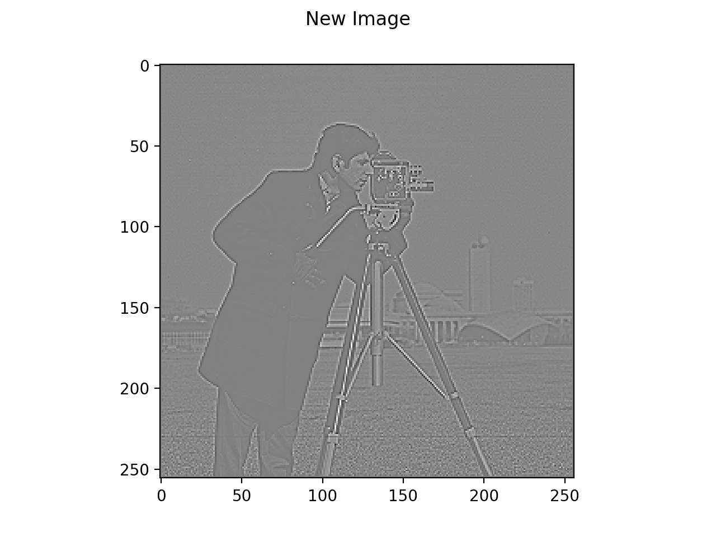
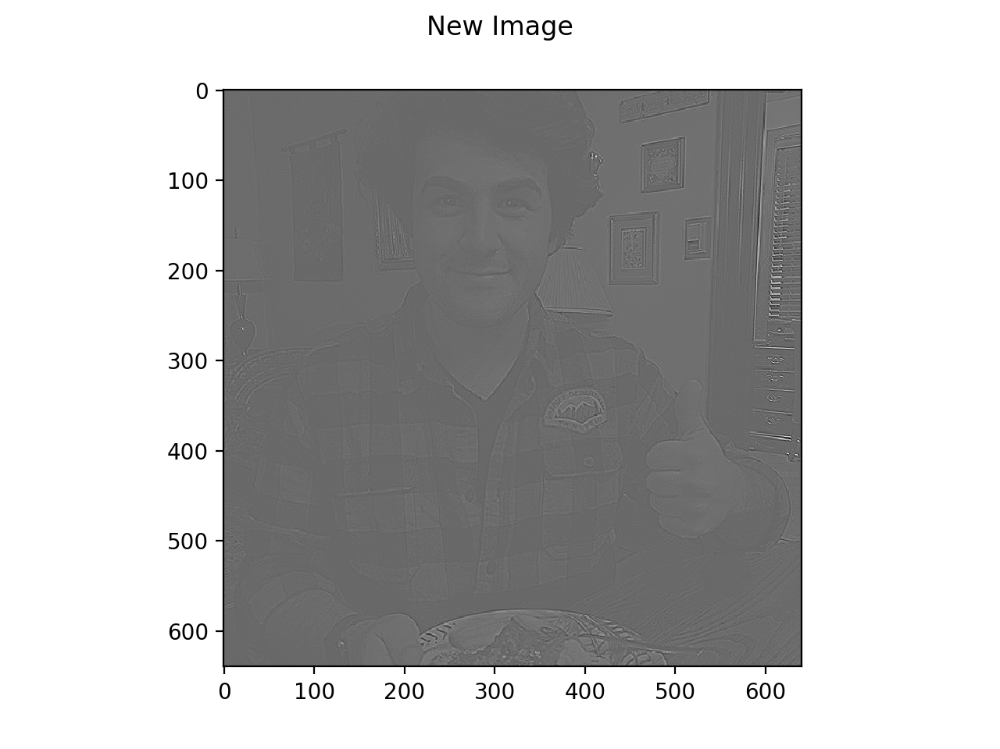

Slide 28
Prewitts Filter
Element wise operation
Horizontal and vertical
Similar operations and procedures as the previous edge detection filters
-1 | -1 | -1
0 | 0 | 0
1 | 1 | 1
-1 | 0 | 1
-1 | 0 | 1
-1 | 0 | 1

Slide 29
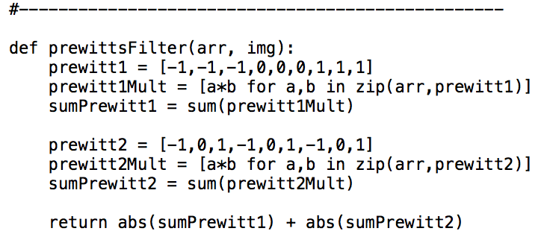
prewitts
function

Slide 30



Slide 31
Comments?

Slide 32
Thank You

